Slide 1
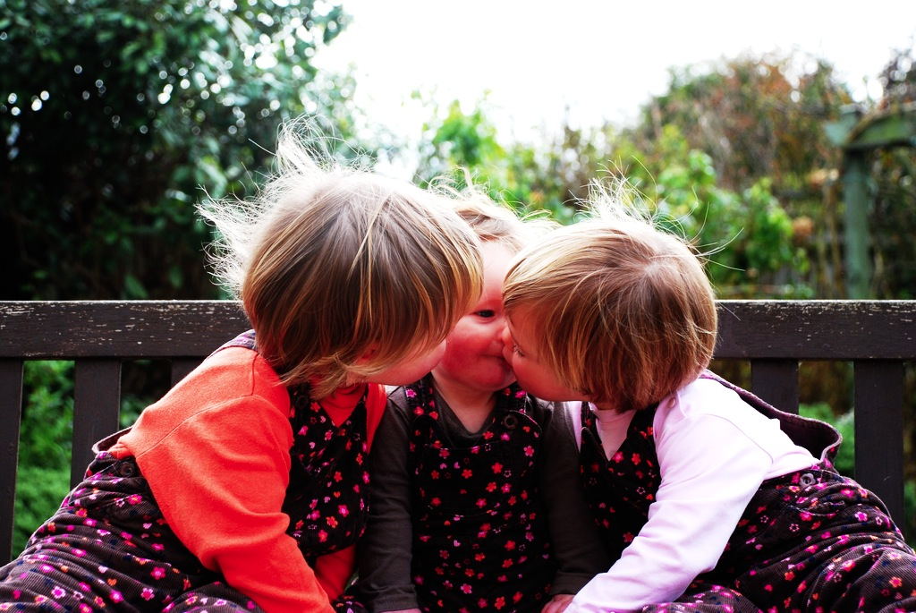

Joint Action and the
Emergence of Mindreading

Slide 2




Notes:
Before I start ... partly to blame for what follows ...

Slide 3
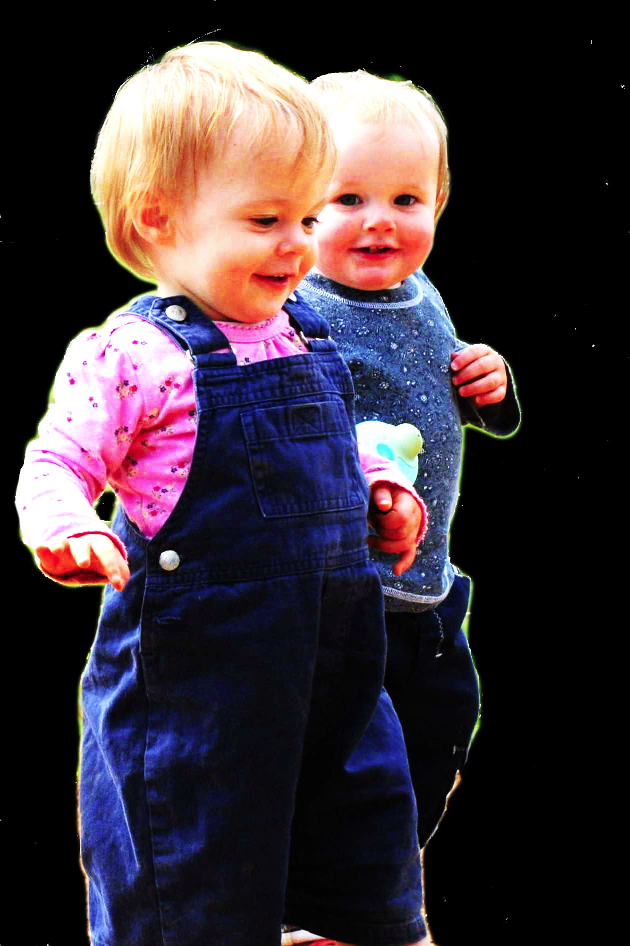
challenge
Explain the emergence, in evolution or development, of sophisticated forms of theory of mind cognition.

Slide 4
challenge
Explain the emergence, in evolution or development, of sophisticated forms of theory of mind cognition.
Representing perceptions, knowledge states and beliefs is hard, for it requires

Slide 5
challenge
Explain the emergence, in evolution or development, of sophisticated forms of social cognition.
Representing perceptions, knowledge states and beliefs is hard, for it requires
(a) conceptual sophistication
- takes years to develop
- development tied to acquisition of executive function and language
- development facilitated by training and siblings
(b) scarce cognitive resources
- attention
- working memory

Slide 6
challenge
Explain the emergence, in evolution or development, of sophisticated forms of social cognition.
Representing perceptions, knowledge states and beliefs is hard, for it requires
(a) conceptual sophistication
- takes years to develop
- development tied to acquisition of executive function and language
- development facilitated by training and siblings
(b) scarce cognitive resources
- attention
- working memory

Slide 7
challenge
Explain the emergence, in evolution or development, of sophisticated forms of social cognition.
Representing perceptions, knowledge states and beliefs is hard, for it requires
(a) conceptual sophistication
- takes years to develop
- development tied to acquisition of executive function and language
- development facilitated by training and siblings
(b) scarce cognitive resources
- attention
- working memory

Slide 8
challenge
Explain the emergence, in evolution or development, of sophisticated forms of theory of mind cognition.

Slide 9


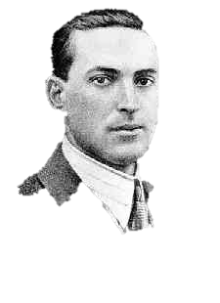
challenge
Explain the emergence, in evolution or development, of sophisticated forms of theory of mind cognition.
“the unique aspects of human cognition ... were driven by, or even constituted by, social co-operation”
(Moll & Tomasello 2007)
“perception, action, and cognition are grounded in social interaction”
(Sebanz & Knoblich 2008)

Slide 10
challenge
Explain the emergence, in evolution or development, of sophisticated forms of theory of mind cognition.
conjecture
The existence of abilities to engage in joint action partially explains how sophisticated forms of theory of mind cognition emerge in evolution or development (or both)

Slide 11
challenge
Explain the emergence, in evolution or development, of sophisticated forms of theory of mind cognition.
conjecture
The existence of abilities to engage in joint action partially explains how sophisticated forms of theory of mind cognition emerge in evolution or development (or both)

Slide 12
challenge
Explain the emergence, in evolution or development, of sophisticated forms of theory of mind cognition.
conjecture
The existence of abilities to engage in joint action partially explains how sophisticated forms of theory of mind cognition emerge in evolution or development (or both)
question 1
What theory of mind cognition does joint action require?

Slide 13
tidying up the toys together
(Behne et al 2005)
cooperatively pulling handles in sequence to make a dog-puppet sing
(Brownell et al 2006)
bouncing a ball on a large trampoline together
(Tomasello & Carpenter 2007)
pretending to row a boat together

Slide 14
painting a house together
(Bratman 1992)
lifting a heavy sofa together
(Velleman 1997)
preparing a hollandaise sauce together
(Searle 1990)
going to Chicago together
(Kutz 2000)
walking together
(Gilbert 1990)
tidying up the toys together
(Behne et al 2005)
cooperatively pulling handles in sequence to make a dog-puppet sing
(Brownell et al 2006)
bouncing a ball on a large trampoline together
(Tomasello & Carpenter 2007)
pretending to row a boat together

Slide 15
shared intention

Slide 16
‘I take a collective action to involve a collective [shared] intention.’
(Gilbert 2006, p. 5)

Slide 17
‘I take a collective action to involve a collective [shared] intention.’
(Gilbert 2006, p. 5)
‘The sine qua non of collaborative action is a joint goal [shared intention] and a joint commitment’
(Tomasello 2008, p. 181)

Slide 18
‘I take a collective action to involve a collective [shared] intention.’
(Gilbert 2006, p. 5)
‘The sine qua non of collaborative action is a joint goal [shared intention] and a joint commitment’
(Tomasello 2008, p. 181)
‘the key property of joint action lies in its internal component [...] in the participants’ having a “collective” or “shared” intention.’
(Alonso 2009, pp. 444-5)
‘Shared intentionality is the foundation upon which joint action is built.’
(Carpenter 2009, p. 381)

Slide 19
What is shared intention?

Slide 20
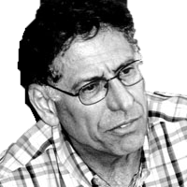
What is shared intention?

Slide 21
What is shared intention?
Functional characterisation
Substantial account

Slide 22
What is shared intention?
Functional characterisation
shared intention serves to (a) coordinate activities, (b) coordinate planning and (c) structure bargaining
Substantial account

Slide 23
What is shared intention?
Functional characterisation
shared intention serves to (a) coordinate activities, (b) coordinate planning and (c) structure bargaining
Substantial account
We have a shared intention that we J if
“1. (a) I intend that we J and (b) you intend that we J
“2. I intend that we J in accordance with and because of la, lb, and meshing subplans of la and lb; you intend [likewise] …
“3. 1 and 2 are common knowledge between us”
(Bratman 1993: View 4)

Slide 24
What is shared intention?
Functional characterisation
shared intention serves to (a) coordinate activities, (b) coordinate planning and (c) structure bargaining
Substantial account
We have a shared intention that we J if
“1. (a) I intend that we J and (b) you intend that we J
“2. I intend that we J in accordance with and because of la, lb, and meshing subplans of la and lb; you intend [likewise] …
“3. 1 and 2 are common knowledge between us”
(Bratman 1993: View 4)
{
Intentions about intentions

Slide 25
What is shared intention?
Functional characterisation
shared intention serves to (a) coordinate activities, (b) coordinate planning and (c) structure bargaining
Substantial account
We have a shared intention that we J if
“1. (a) I intend that we J and (b) you intend that we J
“2. I intend that we J in accordance with and because of la, lb, and meshing subplans of la and lb; you intend [likewise] …
“3. 1 and 2 are common knowledge between us”
(Bratman 1993: View 4)
{
Intentions about intentions
{
Knowledge of others’ knowledge of intentions about intentions

Slide 26
What is shared intention?
Functional characterisation
shared intention serves to (a) coordinate activities, (b) coordinate planning and (c) structure bargaining
Substantial account
We have a shared intention that we J if
“1. (a) I intend that we J and (b) you intend that we J
“2. I intend that we J in accordance with and because of la, lb, and meshing subplans of la and lb; you intend [likewise] …
“3. 1 and 2 are common knowledge between us”
(Bratman 1993: View 4)
{
Intentions about intentions
{
Knowledge of others’ knowledge of intentions about intentions

Slide 27
What is shared intention?
Functional characterisation
shared intention serves to (a) coordinate activities, (b) coordinate planning and (c) structure bargaining
Substantial account
We have a shared intention that we J if
“1. (a) I intend that we J and (b) you intend that we J
“2. I intend that we J in accordance with and because of la, lb, and meshing subplans of la and lb; you intend [likewise] …
“3. 1 and 2 are common knowledge between us”
(Bratman 1993: View 4)

Slide 28
What is shared intention?
Functional characterisation
shared intention serves to (a) coordinate activities, (b) coordinate planning and (c) structure bargaining
Substantial account
We have a shared intention that we J if
“1. (a) I intend that we J and (b) you intend that we J
“2. I intend that we J in accordance with and because of la, lb, and meshing subplans of la and lb; you intend [likewise] …
“3. 1 and 2 are common knowledge between us”
(Bratman 1993: View 4)
‘shared intentional agency consists, at bottom, in interconnected planning agency of the participants.’
(Bratman 2011, p. 11)

Slide 29
1. All (significant) joint actions require shared intention.
2. Shared intention requires sophisticated theory of mind cognition.
Therefore:
3. Abilities to engage in joint action could play no significant role in explaining how sophisticated theory of mind cognition emerges.

Slide 30
1. All (significant) joint actions require shared intention.
2. Shared intention requires sophisticated theory of mind cognition.
Therefore:
3. Abilities to engage in joint action could play no significant role in explaining how sophisticated theory of mind cognition emerges.
(not why)

Slide 31
1. All (significant) joint actions require shared intention.
2. Shared intention requires sophisticated theory of mind cognition.
Therefore:
3. Abilities to engage in joint action could play no significant role in explaining how sophisticated theory of mind cognition emerges.

Slide 32
1. All (significant) joint actions require shared intention.
2. Shared intention requires sophisticated theory of mind cognition.
Therefore:
3. Abilities to engage in joint action could play no significant role in explaining how sophisticated theory of mind cognition emerges.

Slide 33
Joint action:
an action with two or more agents (Ludwig 2007)

Slide 34
Joint action:
an action with two or more agents (Ludwig 2007)

Slide 35
Joint action:
an action with two or more agents (Ludwig 2007)
‘our primitive actions, the ones we do not by doing something else, ... these are all the actions there are.’ (Davidson 1971, p. 59).

Slide 36
Joint action:
an action with two or more agents (Ludwig 2007)
‘our primitive actions, the ones we do not by doing something else, ... these are all the actions there are.’ (Davidson 1971, p. 59).
move fingers
unlock door
turn key

Slide 37
Joint action:
an action with two or more agents (Ludwig 2007)
‘our primitive actions, the ones we do not by doing something else, ... these are all the actions there are.’ (Davidson 1971, p. 59).
move fingers
unlock door
turn key

Slide 38
Joint action:
an action with two or more agents (Ludwig 2007)
‘our primitive actions, the ones we do not by doing something else, ... these are all the actions there are.’ (Davidson 1971, p. 59).
move fingers
unlock door
turn key

Slide 39
Joint action:
an action with two or more agents (Ludwig 2007)
‘our primitive actions, the ones we do not by doing something else, ... these are all the actions there are.’ (Davidson 1971, p. 59).
tidying up the toys together
(Behne et al 2005)
cooperatively pulling handles in sequence to make a dog-puppet sing
(Brownell et al 2006)
bouncing a ball on a large trampoline together
(Tomasello & Carpenter 2007)
pretending to row a boat together
move fingers
unlock door
turn key

Slide 40
Joint action:
an action with two or more agents (Ludwig 2007)
‘our primitive actions, the ones we do not by doing something else, ... these are all the actions there are.’ (Davidson 1971, p. 59).
tidying up the toys together
(Behne et al 2005)
cooperatively pulling handles in sequence to make a dog-puppet sing
(Brownell et al 2006)
bouncing a ball on a large trampoline together
(Tomasello & Carpenter 2007)
pretending to row a boat together
move fingers
unlock door
turn key

Slide 41
Joint action:
an action with two or more agents (Ludwig 2007)
tidying up the toys together
(Behne et al 2005)
cooperatively pulling handles in sequence to make a dog-puppet sing
(Brownell et al 2006)
bouncing a ball on a large trampoline together
(Tomasello & Carpenter 2007)
pretending to row a boat together
my pulling
dog’s singing
your pulling
We make the dog sing

Slide 42
Joint action:
an action with two or more agents (Ludwig 2007)
tidying up the toys together
(Behne et al 2005)
cooperatively pulling handles in sequence to make a dog-puppet sing
(Brownell et al 2006)
bouncing a ball on a large trampoline together
(Tomasello & Carpenter 2007)
pretending to row a boat together
my pulling
dog’s singing
your pulling
We make the dog sing

Slide 43
1
Joint action:
an action with two or more agents (Ludwig 2007)
Bodily movements ‘are all the actions there are’ (Davidson 1971, p. 59)
In supposedly paradigm cases of joint action, there are no bodily movements with more than one agent.
Therefore:
Supposedly paradigm cases are not joint actions.
tidying up the toys together
(Behne et al 2005)
cooperatively pulling handles in sequence to make a dog-puppet sing
(Brownell et al 2006)
bouncing a ball on a large trampoline together
(Tomasello & Carpenter 2007)
pretending to row a boat together
2
3
4

Slide 44
1
too narrow
Joint action:
an action with two or more agents (Ludwig 2007)
Bodily movements ‘are all the actions there are’ (Davidson 1971, p. 59)
In supposedly paradigm cases of joint action, there are no bodily movements with more than one agent.
Therefore:
Supposedly paradigm cases are not joint actions.
tidying up the toys together
(Behne et al 2005)
cooperatively pulling handles in sequence to make a dog-puppet sing
(Brownell et al 2006)
bouncing a ball on a large trampoline together
(Tomasello & Carpenter 2007)
pretending to row a boat together
2
3
4

Slide 45
?
1
too narrow
Joint action:
an action with two or more agents (Ludwig 2007)
Bodily movements ‘are all the actions there are’ (Davidson 1971, p. 59)
In supposedly paradigm cases of joint action, there are no bodily movements with more than one agent.
Therefore:
Supposedly paradigm cases are not joint actions.
tidying up the toys together
(Behne et al 2005)
cooperatively pulling handles in sequence to make a dog-puppet sing
(Brownell et al 2006)
bouncing a ball on a large trampoline together
(Tomasello & Carpenter 2007)
pretending to row a boat together
2
3
4

Slide 46
?
1
too narrow
Joint action:
an action with two or more agents (Ludwig 2007)
Bodily movements ‘are all the actions there are’ (Davidson 1971, p. 59)
In supposedly paradigm cases of joint action, there are no bodily movements with more than one agent.
Therefore:
Supposedly paradigm cases are not joint actions.
tidying up the toys together
(Behne et al 2005)
cooperatively pulling handles in sequence to make a dog-puppet sing
(Brownell et al 2006)
bouncing a ball on a large trampoline together
(Tomasello & Carpenter 2007)
pretending to row a boat together
2
3
4
Notes:
we could reject this ... but I want to pursue a different approach

Slide 47
1
too narrow
Joint action:
an action with two or more agents (Ludwig 2007)
Bodily movements ‘are all the actions there are’ (Davidson 1971, p. 59)
In supposedly paradigm cases of joint action, there are no bodily movements with more than one agent.
Therefore:
Supposedly paradigm cases are not joint actions.
tidying up the toys together
(Behne et al 2005)
cooperatively pulling handles in sequence to make a dog-puppet sing
(Brownell et al 2006)
bouncing a ball on a large trampoline together
(Tomasello & Carpenter 2007)
pretending to row a boat together
2
3
4
Notes:
we could reject this ... but I want to pursue a different approach

Slide 48
Joint action:
an action with two or more agents (Ludwig 2007)

Slide 49
Joint action:
an action event with two or more agents (Ludwig 2007)

Slide 50
Grounding
events D₁, ... D_{n} ground E, if:
D₁, ... D_{n} and E occur;
D₁, ... D_{n} are each (perhaps improper) parts of E; and
every event that is a proper part of E but does not overlap D₁,...D_{n} is caused by some or all of D₁, ... D_{n}.
Agency
For an individual to be among the agents of an event is for there to be actions a₁, ... a_{n} which ground this event where the individual is an agent of one or more of these actions.
(Adapted from Pietroski 1998)

Slide 51
Joint action:
an action event with two or more agents (Ludwig 2007)

Slide 52
Joint action:
an action event with two or more agents (Ludwig 2007)
tidying up the toys together
(Behne et al 2005)
cooperatively pulling handles in sequence to make a dog-puppet sing
(Brownell et al 2006)
bouncing a ball on a large trampoline together
(Tomasello & Carpenter 2007)
pretending to row a boat together
my pulling
dog’s singing
your pulling
We make the dog sing

Slide 53
Joint action:
an action event with two or more agents (Ludwig 2007)
tidying up the toys together
(Behne et al 2005)
cooperatively pulling handles in sequence to make a dog-puppet sing
(Brownell et al 2006)
bouncing a ball on a large trampoline together
(Tomasello & Carpenter 2007)
pretending to row a boat together

Slide 54
Joint action:
an action event with two or more agents (Ludwig 2007)
tidying up the toys together
(Behne et al 2005)
cooperatively pulling handles in sequence to make a dog-puppet sing
(Brownell et al 2006)
bouncing a ball on a large trampoline together
(Tomasello & Carpenter 2007)
pretending to row a boat together
Nora’s shooting
Fred’s death
Olive’s shooting
Fred’s killing

Slide 55
too broad
Joint action:
an action event with two or more agents (Ludwig 2007)
tidying up the toys together
(Behne et al 2005)
cooperatively pulling handles in sequence to make a dog-puppet sing
(Brownell et al 2006)
bouncing a ball on a large trampoline together
(Tomasello & Carpenter 2007)
pretending to row a boat together
Nora’s shooting
Fred’s death
Olive’s shooting
Fred’s killing

Slide 56
too broad
Joint action:
an action event with two or more agents (Ludwig 2007)
tidying up the toys together
(Behne et al 2005)
cooperatively pulling handles in sequence to make a dog-puppet sing
(Brownell et al 2006)
bouncing a ball on a large trampoline together
(Tomasello & Carpenter 2007)
pretending to row a boat together
Nora’s shooting
Fred’s death
Olive’s shooting
Fred’s killing

Slide 57
Goal-directed joint action: an event with two or more agents which, taken as a whole, is directed to a goal.
tidying up the toys together
(Behne et al 2005)
cooperatively pulling handles in sequence to make a dog-puppet sing
(Brownell et al 2006)
bouncing a ball on a large trampoline together
(Tomasello & Carpenter 2007)
pretending to row a boat together
Nora’s shooting
Fred’s death
Olive’s shooting
Fred’s killing

Slide 58
Goal-directed joint action: an event with two or more agents which, taken as a whole, is directed to a goal.
tidying up the toys together
(Behne et al 2005)
cooperatively pulling handles in sequence to make a dog-puppet sing
(Brownell et al 2006)
bouncing a ball on a large trampoline together
(Tomasello & Carpenter 2007)
pretending to row a boat together
cooperatively pulling handles in sequence to make a dog-puppet sing
(Brownell et al 2006)
my pulling
dog’s singing
your pulling
We make the dog sing

Slide 59
Goal-directed joint action: an event with two or more agents which, taken as a whole, is directed to a goal.
out
out
act
out
act
out

Slide 60
Goal-directed joint action: an event with two or more agents which, taken as a whole, is directed to a goal.
out
out
act
represents
coordinates
out
act
shared intention
out

Slide 61
Goal-directed joint action: an event with two or more agents which, taken as a whole, is directed to a goal.
???
out
out
act
represents
coordinates
out
act
shared intention
out

Slide 62
Detour
Goals are not intentions

Slide 63
What is the relation between an action and the goal (or goals) to which it is directed?
out
out
act
out
out

Slide 64
What is the relation between an action and the goal (or goals) to which it is directed?
out
out
act
out
out

Slide 65
What is the relation between an action and the goal (or goals) to which it is directed?
out
out
act
out
intention or other goal-state
out

Slide 66
What is the relation between an action and the goal (or goals) to which it is directed?
teleological function
out
out
act
out
intention or other goal-state
out

Slide 67
(i) in the past, actions of this type have caused outcomes of this type; (ii) this action happens now in part because (i).
What is the relation between an action and the goal (or goals) to which it is directed?
teleological function
out
out
act
out
intention or other goal-state
out

Slide 68
(i) in the past, actions of this type have caused outcomes of this type; (ii) this action happens now in part because (i).
What is the relation between an action and the goal (or goals) to which it is directed?
teleological function
out
out
act
out
intention or other goal-state
It is possible to represent goal-directed actions without representing intentions.
out

Slide 69
End Detour

Slide 70
Goal-directed joint action: an event with two or more agents which, taken as a whole, is directed to a goal.
???
out
out
act
represents
coordinates
out
act
shared intention
out

Slide 71
Goal-directed joint action: an event with two or more agents which, taken as a whole, is directed to a goal.
G is a distributive goal: it is an outcome to which each agent’s activities are individually directed and it is possible that: all agents succeed relative to this outcome.

Slide 72
Goal-directed joint action: an event with two or more agents which, taken as a whole, is directed to a goal.
G is a distributive goal: it is an outcome to which each agent’s activities are individually directed and it is possible that: all agents succeed relative to this outcome.
G is a collective goal
(a) it is a distributive goal;
(b) the agents’ activities are coordinated; and
(c) coordination of this type would normally facilitate occurrences of outcomes of this type.

Slide 73
Goal-directed joint action: an event with two or more agents which, taken as a whole, is directed to a goal.
G is a distributive goal: it is an outcome to which each agent’s activities are individually directed and it is possible that: all agents succeed relative to this outcome.
G is a collective goal
(a) it is a distributive goal;
(b) the agents’ activities are coordinated; and
(c) coordination of this type would normally facilitate occurrences of outcomes of this type.

Slide 74
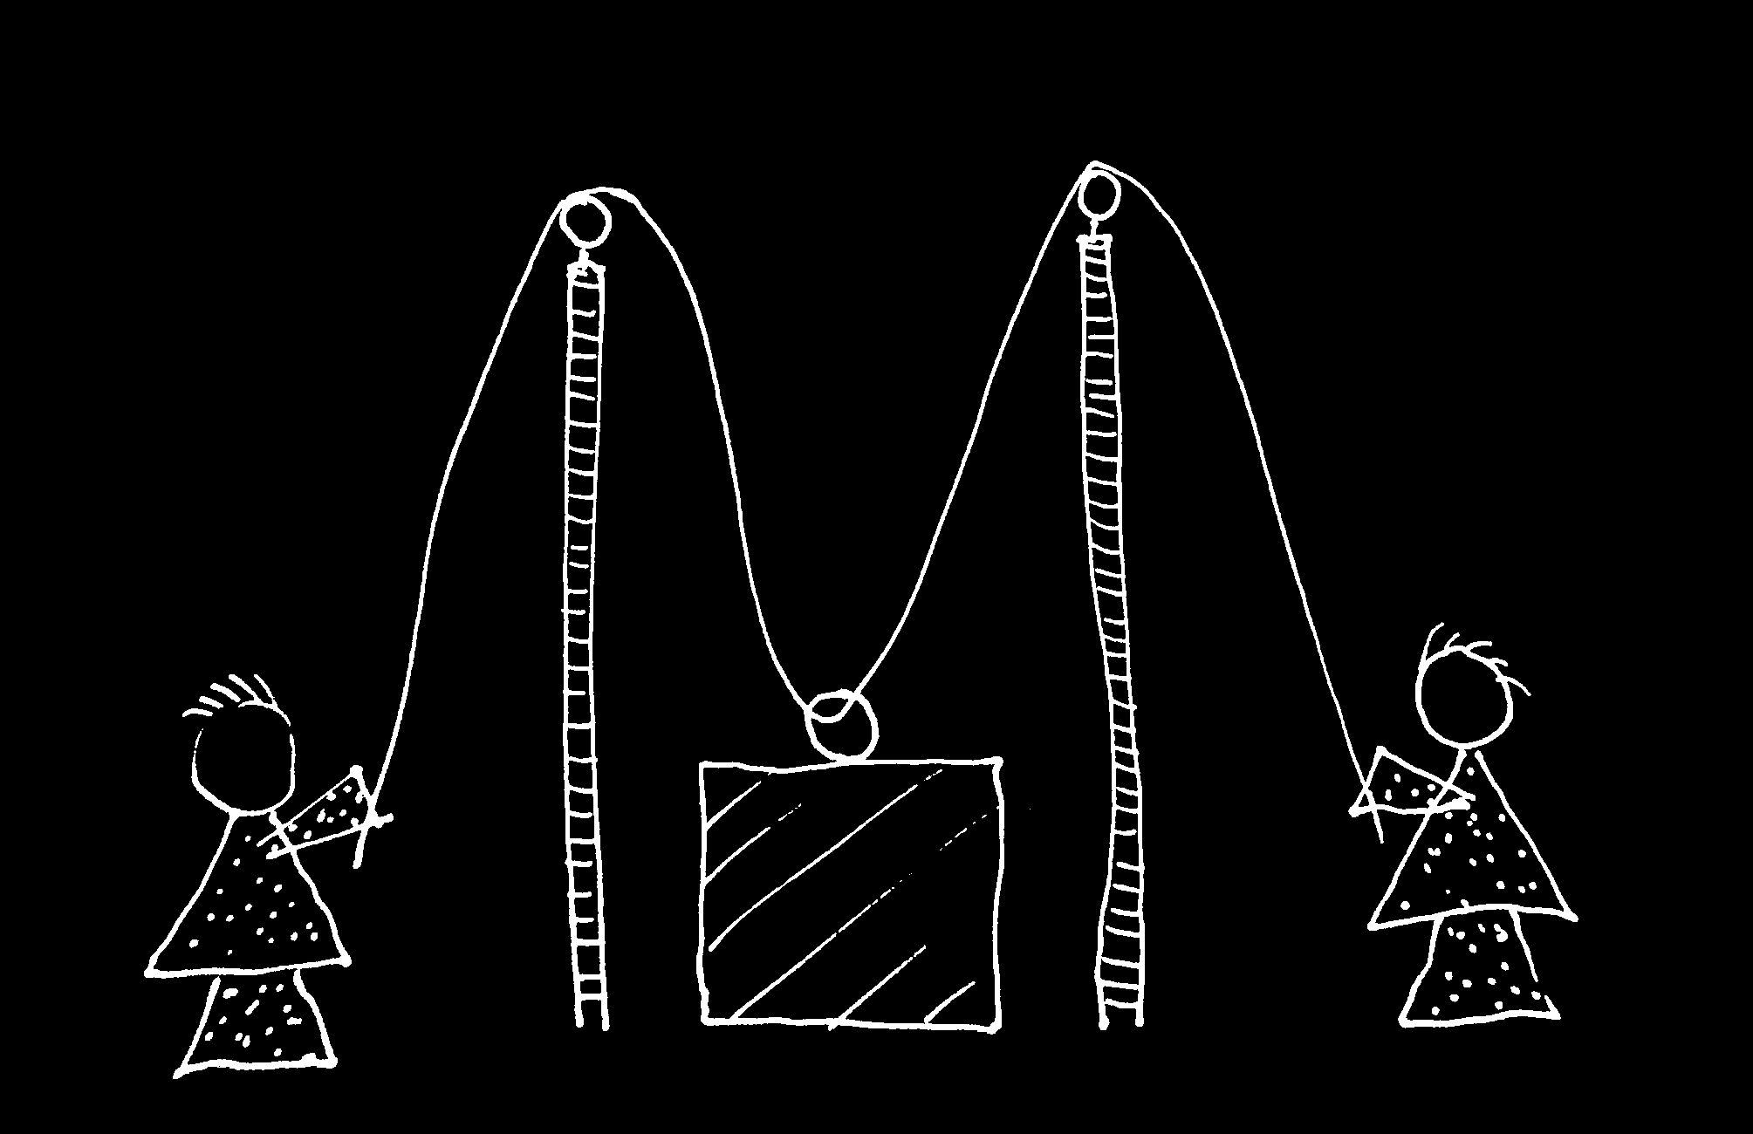

Slide 75


Slide 76
sting
sting
sting
sting
sting
death of fly
sting
sting
sting

Slide 77
Goal-directed joint action: an event with two or more agents which, taken as a whole, is directed to a goal.
G is a distributive goal: it is an outcome to which each agent’s activities are individually directed and it is possible that: all agents succeed relative to this outcome.
G is a collective goal
(a) it is a distributive goal;
(b) the agents’ activities are coordinated; and
(c) coordination of this type would normally facilitate occurrences of outcomes of this type.

Slide 78
Goal-directed joint action: an event with two or more agents which, taken as a whole, is directed to a goal.
G is a distributive goal: it is an outcome to which each agent’s activities are individually directed and it is possible that: all agents succeed relative to this outcome.
G is a shared goal
G is a collective goal
(a) it is a distributive goal;
(b) the agents’ activities are coordinated; and
(c) coordination of this type would normally facilitate occurrences of outcomes of this type.
Each agent expects each of the other agents to perform activities directed to the goal.
Each agent expects the goal to occur as a common effect of all their goal-directed actions.

Slide 79
Joint action:
an action event with two or more agents (Ludwig 2007)

Slide 80
challenge
Explain the emergence, in evolution or development, of sophisticated forms of theory of mind cognition.
conjecture
The existence of abilities to engage in joint action partially explains how sophisticated forms of theory of mind cognition emerge in evolution or development (or both)
question 1
What theory of mind cognition does joint action require?

Slide 81
Goal-directed joint action: an event with two or more agents which, taken as a whole, is directed to a goal.
G is a distributive goal: it is an outcome to which each agent’s activities are individually directed and it is possible that: all agents succeed relative to this outcome.
G is a shared goal
G is a collective goal
(a) it is a distributive goal;
(b) the agents’ activities are coordinated; and
(c) coordination of this type would normally facilitate occurrences of outcomes of this type.
Each agent expects each of the other agents to perform activities directed to the goal.
Each agent expects the goal to occur as a common effect of all their goal-directed actions.

Slide 82

joint action &
knowing
others’
minds
Notes:
This is an overview of the project and its aims

Slide 83
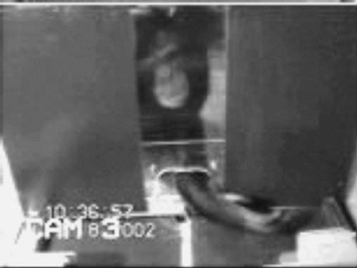
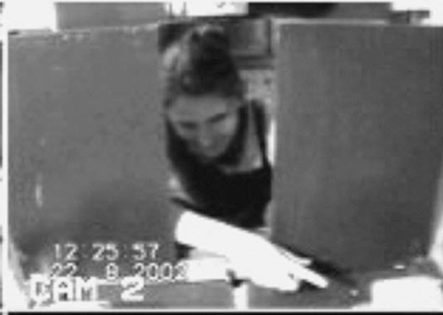
failed reach
point
source: Hare & Tomasello (2004)
Notes:
this illustrates problem of identifying particular goals of action

Slide 84
The problem of opaque means

Slide 85
The problem of false belief

Slide 86
your-goal-is-my-goal

Slide 87
your-goal-is-my-goal
1. We are about to engage in some joint action* or other
2. I am not about to change my goal.
Therefore:
3. Your actions also will be directed to this goal.
[*in at least the minimal sense associated with distributive goals]

Slide 88
failed reach
point
source: Hare & Tomasello (2004)

Slide 89
failed reach
point
source: Hare & Tomasello (2004)
“to understand pointing, the subject needs to understand more than the individual goal-directed behaviour. She needs to understand that ... the other attempts to communicate to her ... and ... the communicative intention behind the gesture”
(Moll & Tomsello 2007)

Slide 90
failed reach
point
source: Hare & Tomasello (2004)
“to understand pointing, the subject needs to understand more than the individual goal-directed behaviour. She needs to understand that ... the other attempts to communicate to her ... and ... the communicative intention behind the gesture”
(Moll & Tomsello 2007)

Slide 91
Csibra’s ‘two stances’:
Teleological and referential action interpretation ‘rely on different kinds of action understanding’
These are initially two distinct ‘action interpretation systems’ and they come together later in development
Csibra (2003, p. 456)

Slide 92

minimal theory of mind cognition
joint action (ability to share goals)
understanding communicative intent
other stuff
communication by language
other stuff
full-blown theory of mind cognition

Slide 94

appendix
What could infants, chimps and scrub-jays represent that would enable them, within limits, to track others’ perceptions, knowledge, beliefs and other propositional attitudes?

Slide 95




Intentional relation
e.g. She is interested in that chocolate
e.g. She is smiling at me
Propositional attitude
e.g. She believes that the chocolate is in that cupboard

Slide 96

Your field = a set of objects related to you by proximity, orientation, lighting and other factors
You encounter an object = it is in your field
You register an object at a location = you most recently encountered the object at that location

Slide 97
Your field = a set of objects related to you by proximity, orientation, lighting and other factors
You encounter an object = it is in your field
You register an object at a location = you most recently encountered the object at that location
proximity
orientation
lighting
barriers
trajectory

Slide 98
Your field = a set of objects related to you by proximity, orientation, lighting and other factors
You encounter an object = it is in your field
You register an object at a location = you most recently encountered the object at that location
proximity
orientation
lighting
barriers
trajectory

Slide 99
Your field = a set of objects related to you by proximity, orientation, lighting and other factors
You encounter an object = it is in your field
You register an object at a location = you most recently encountered the object at that location
Principle 1: one can’t goal-directedly act on an object unless one has encountered it.
Principle 2: correct registration is a condition of successful action.
Principle 3: when an agent performs a goal-directed action and the goal specifies an object, the agent will act as if the object were actually in the location she registers it at.
proximity
orientation
lighting
barriers
trajectory

Slide 100
Your field = a set of objects related to you by proximity, orientation, lighting and other factors
You encounter an object = it is in your field
You register an object at a location = you most recently encountered the object at that location
Principle 1: one can’t goal-directedly act on an object unless one has encountered it.
Principle 2: correct registration is a condition of successful action.
Principle 3: when an agent performs a goal-directed action and the goal specifies an object, the agent will act as if the object were actually in the location she registers it at.
proximity
orientation
lighting
barriers
trajectory

Slide 101
Your field = a set of objects related to you by proximity, orientation, lighting and other factors
You encounter an object = it is in your field
You register an object at a location = you most recently encountered the object at that location
Principle 1: one can’t goal-directedly act on an object unless one has encountered it.
Principle 2: correct registration is a condition of successful action.
Principle 3: when an agent performs a goal-directed action and the goal specifies an object, the agent will act as if the object were actually in the location she registers it at.
proximity
orientation
lighting
barriers
trajectory

Slide 102
Your field = a set of objects related to you by proximity, orientation, lighting and other factors
You encounter an object = it is in your field
You register an object at a location = you most recently encountered the object at that location
Principle 1: one can’t goal-directedly act on an object unless one has encountered it.
Principle 2: correct registration is a condition of successful action.
Principle 3
proximity
orientation
lighting
barriers
trajectory

Slide 103
Your field = a set of objects related to you by proximity, orientation, lighting and other factors
You encounter an object = it is in your field
You register an object at a location = you most recently encountered the object at that location
Principle 1: one can’t goal-directedly act on an object unless one has encountered it.
Principle 2: correct registration is a condition of successful action.
Principle 3: when an agent performs a goal-directed action and the goal specifies an object, the agent will act as if the object were actually in the location she registers it at.
proximity
orientation
lighting
barriers
trajectory

Slide 104

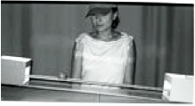
source Träuble, Marinovic, & Pauen (2010)

Slide 105
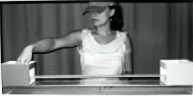
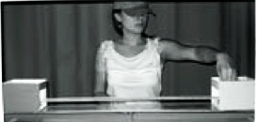
source Träuble, Marinovic, & Pauen (2010)

Slide 106
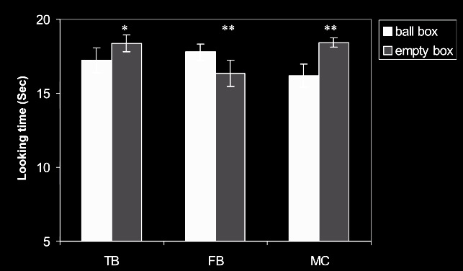
source Träuble, Marinovic, & Pauen (2010)

Slide 107
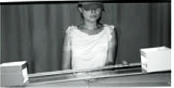
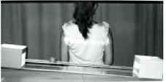
source Träuble, Marinovic, & Pauen (2010)

Slide 108
source Träuble, Marinovic, & Pauen (2010)

Slide 109
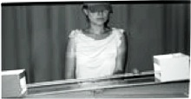
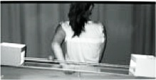
source Träuble, Marinovic, & Pauen (2010)

Slide 110
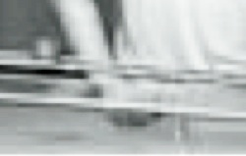
source Träuble, Marinovic, & Pauen (2010)

Slide 111
source Träuble, Marinovic, & Pauen (2010)

Slide 112
Your field = a set of objects related to you by proximity, orientation, lighting and other factors
You encounter an object = it is in your field
You register an object at a location = you most recently encountered the object at that location
Principle 1: one can’t goal-directedly act on an object unless one has encountered it.
Principle 2: correct registration is a condition of successful action.
Principle 3: when an agent performs a goal-directed action and the goal specifies an object, the agent will act as if the object were actually in the location she registers it at.
proximity
orientation
lighting
barriers
trajectory

Slide 113
Your field = a set of objects related to you by proximity, orientation, lighting and other factors
You encounter an object = it is in your field
You register an object at a location = you most recently encountered the object at that location
Principle 1: one can’t goal-directedly act on an object unless one has encountered it.
Principle 2: correct registration is a condition of successful action.
Principle 3: when an agent performs a goal-directed action and the goal specifies an object, the agent will act as if the object were actually in the location she registers it at.
proximity
orientation
lighting
barriers
trajectory

Slide 114
Principle 2: correct registration is a condition of successful action.
source Träuble, Marinovic, & Pauen (2010)

Slide 115
signature limits

Slide 116
1. Charly is Samantha
2. Mitch believes that Charly is in Baltimore
3. Mitch believes that Samantha is in Baltimore
(1) & (2) ⇒ (3)

Slide 117
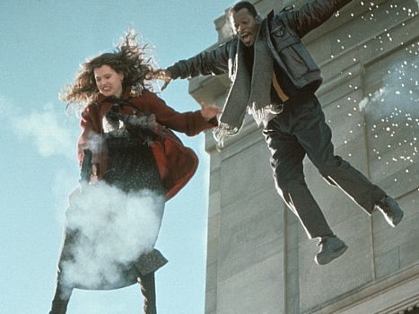
1. Charly is Samantha
2. Mitch believes that Charly is in Baltimore
3. Mitch believes that Samantha is in Baltimore
(1) & (2) ⇒ (3)

Slide 118
1. Charly is Samantha
2. Mitch believes that Charly is in Baltimore
3. Mitch believes that Samantha is in Baltimore
(1) & (2) ⇒ (3)
4. Mitch registers <Charly, Baltimore>
5. Mitch registers <Samantha, Baltimore>
(1) & (4) ⇒ (5)

Slide 119
False belief about location
False belief about identity
Subjects represent registration
Subjects represent beliefs
pass
fail
pass
pass

Slide 120
